Slide 1
FABJON’S INVESTMENT INC.
Fabjon,Jackie, Asazria,Christy
816
PowerPoint Presentation

Slide 2
The Goal For Our Group…
Our Goal when we started was to focus on the NASDAQ and sell and buy technology Stocks.
Some of the many technology stocks we bought are Apple(AAPL),Google(GOOG),Microsoft(MSFT), etc…

Slide 3
Our Group’s Focus.
Our main focus as a group when we started this activity was Technology, we chose to go with technology because it was doing very well at the time.

Slide 4
We Picked a wide variety of stocks throughout this experience , our group tried to keep our focus on technology but as time went on we decided to expand our interest's and invest in food and beverage stock, etc…
Many of our stocks were not very successful but as stocks went down gold started to go up, some of our unsuccessful stocks are Google, yahoo, oil stocks, McDonalds, etc….

Slide 5
Stocks Portfolio Breakdown…

Slide 6
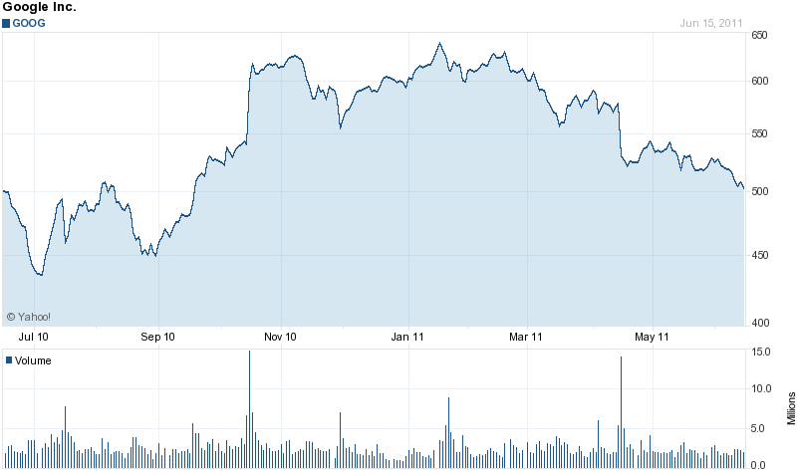
Google Stock Performance…

Slide 7
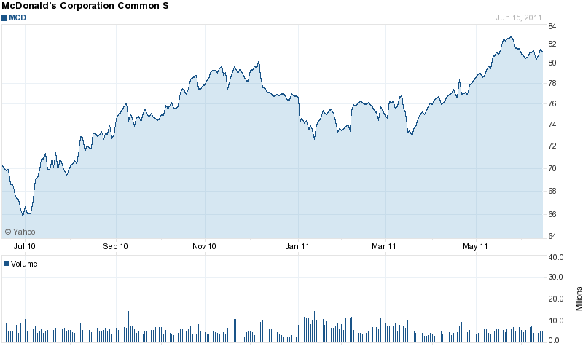
McDonalds Stock Performance…

Slide 8
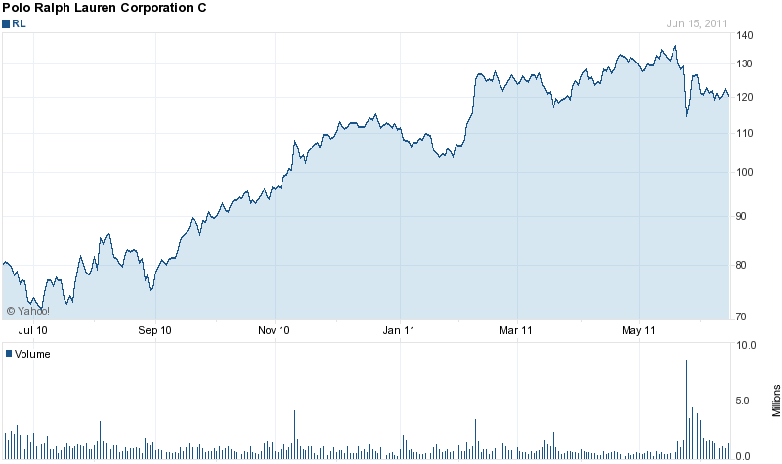
Ralph Lauren Stock Performance…

Slide 9
Why You Should Invest With us…
Our group is very determined to buy and sell strong stocks such as the many companies that we have already invested with such as food and beverage companies, clothing companies, technology, etc…
We are really looking forward to investing with others and making us both very succsesful.

Slide 10
Thank You For Supporting Fabjon’s Investments INC.
We’d like to thank our fellow investors and supporters for taking their time to view this brief presentation.
If you would like to contact us please use the information below:
Email: Fabjon101@aim.com
Cell: 1-347-987-7171
Fax: 1-347-987-7172

