Slide 1
Brooklyn Capital
“We Share Because We Care”
Group Members
Jeffrey Gaspar
Raed
Raymond Tung
Johnathan Hernandez

Slide 2
Frequently Asked Questions
As a common investor, we can imagine the questions you’re probably thinking. What’s the focus of our investment group? What types of stocks do we invest in, and are these investments smart? Basically each and every investor wonders about our history, and as the title states, these are frequently asked questions. Our overall focus of the investment group is to invest in everyday items such as food, electronics, and clothing. The reason as to why these everyday items are smart investments is because of how commonly they are used. The more the item is used/bought, the higher the shares value becomes, and because we invest in everyday items, our stocks have always been a smart investment.

Slide 3
Logos

Slide 4
Portfolio Summary
We included many shares such as McDonalds, Nike, Disney, Sony, ect. We included McDonalds because it’s a commonly bought stock which has been around for around 60 years! Some stocks did well and others didn’t. Every day has a new impact to stocks, and as we all know, every stock has their days. Johnson and Johnson wasn’t a good investment and it didn’t do good for a limited amount of time. Nike was a good investment which positively increased each and every day.

Slide 5
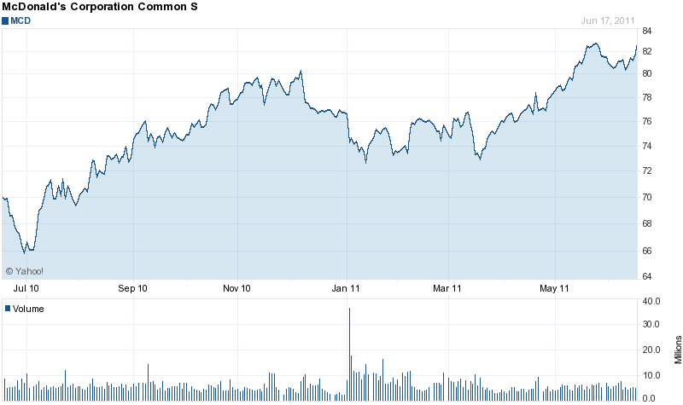
A Year Development of McDonalds

Slide 7
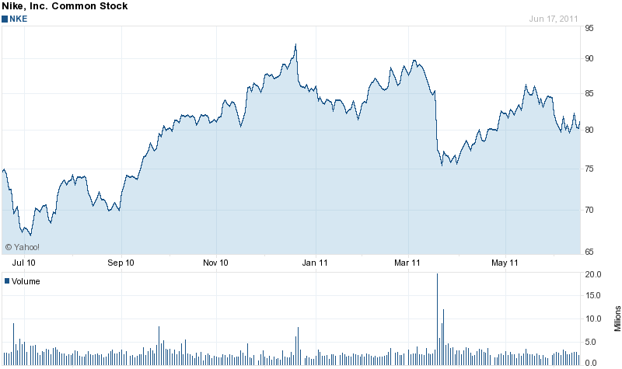
A Year Development of Nike

Slide 8
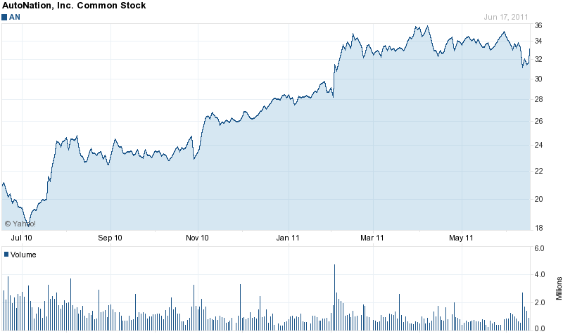
A Year Development of AutoNation Inc.

Slide 9
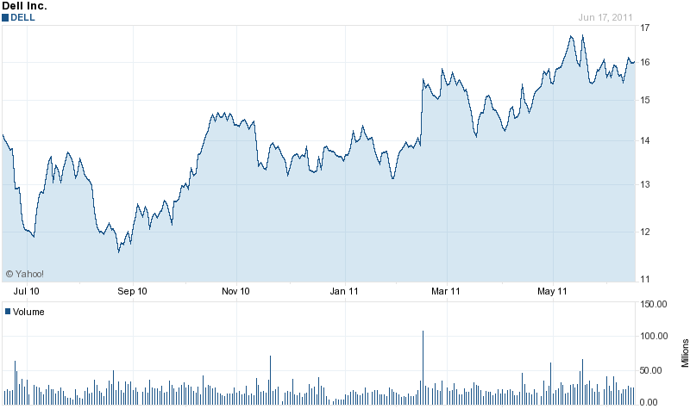
A Year Development of Dell Inc.

Slide 10
A Year Development of Amazon.com Inc.

Slide 11
Reasons of Investment
People should invest in our group because of our major studies. We have an educated, trained professional who is consistently reviewing and studying the stock market.
We have also been investing in the stock market for over ten years and to this day, we are still standing strong
The evidence shown in all of our graphs prove that our investments are not only smart, but highly profitable.
Our stocks mainly consist of commonly bought shares. What that means is that shares that are bought more often increases in value. Since we

Slide 12
Thank you for supporting Brooklyn capital!!!
Thank You for taking time to hear us out. We really appreciate and value your contributions. Brooklyn Capital improves each and everyday due to paying investors like you. If you have any questions or concerns, you can contact us at
1-(800)-CAPITAL, or email us at brooklyncap@gmail.com

