Slide 1

Banking Info Session
Mr Frangella
By PresenterMedia.com

Slide 2

Agenda
Purpose of banks
Types of Accounts
Making a Profit
Banker Roles and responsibilities
Presentation requirement and advertising

Slide 3
Why become a class banker?
Looks good on a HS Application – It’s a leadership role
Helps your math skills
Teaches you how the modern financial system works
Can help you learn how to invest and make money in real life
You will earn a weekly salary and can make a profit so you can buy things like HW passes and pizza!
Bankers make a lot of $$ in real life

Slide 4
Purpose of Banks
Why should we have banks anyways?
Bank
Lend money to students who need it.
A safe place for students to keep their money
A means of investment (interest)
Allows for faster and more convenient transactions (checks and checking accounts)

Slide 5
Purpose of Banks
Why should we have banks anyways?
Banks
Saving
Savings Accounts
Checking Accounts
Borrowing
Loans
Treasury Bonds

Slide 6
Interest
Before we go on, we must define what INTEREST is.
…….any suggestions?
Interest is calculated using percent
Banks pay interest to customers who save money in their bank.
People who borrow money from a bank must also pay interest….You can’t get money for free!

Slide 7
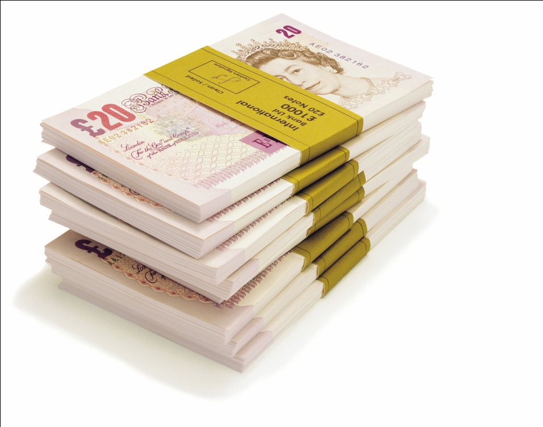
Other Definitions
Withdraw : To take out money from an account
Deposit : To put money into an account
Loan : An amount of money you borrow from a bank.
Balance: The amount of money that is in an account

Slide 8
Types of Accounts
Checking vs. Savings
Checking Accounts
Savings Accounts
Banks do not pay interest
Money is easy for client to get to
Students can write checks to pay people and can cash checks written to them with this account (good for people with jobs, who get paid by check).
ATMS, Debit cards
Banks pay clients interest.
Money is more difficult to get to. Clients may only be able to withdraw their money a few time per month. Banks can charge fees if clients do not follow these rules.
Cannot deposit checks into a savings account

Slide 9

Savings Accounts
For example:
Let’s say John has $100 deposited in his savings account, which pays him a monthly interest of 5%. This means that by the end of the month, how much will he have?
Interest rates will depend on competition between the class’s banks (usually between 2 and 5 %)
Interest should be calculated monthly
Usually banks put restrictions on how often someone can withdraw from a savings account (ex: no more than 4 times a month).
If someone goes over this limit, the bank can charge a fee and make money.

Slide 10
EACH STUDENT WILL START OUT WITH $30 IN A CHECKING ACCOUNT, WHICH I WILL DEPOSIT FOR THEM.
IN ORDER FOR STUDENTS TO GET THIS MONEY, THEY MUST OPEN AN ACCOUNT AT A BANK!!
ALL BANK ACCOUNTS WILL BE INSURED UP TO $100 PER STUDENT. (Meaning if something bad happens, like a robbery, students will get up to $100 back from the government)

Slide 11
Record Keeping
Banks need to keep organized records for each account. Every time someone deposits or withdraws money, (what is called a transaction), you must write it down in that accounts “statement”.
A statement is a document that lists the date, how much the client withdrew or deposited, how much interest is paid or owed, and the balance.

Slide 12
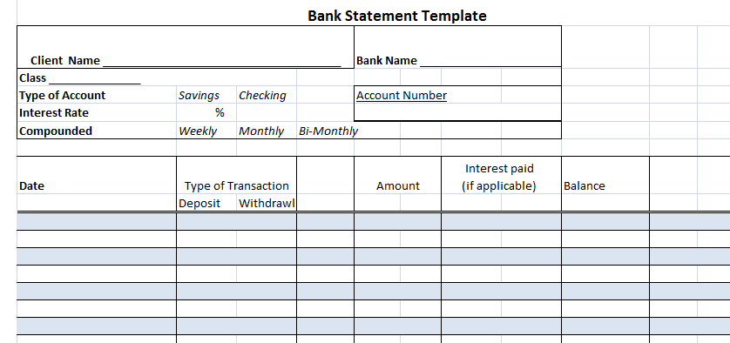
Record Keeping

Slide 13
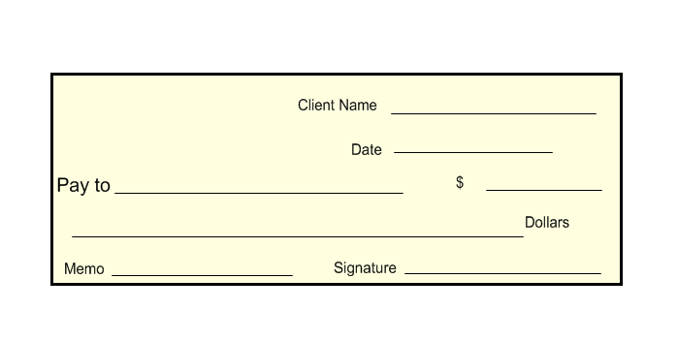
Record Keeping
I’m leaving it up to you…….
Withdrawl Form Bank Name_________________________ Date _______________
Name __________________________ Account # _____________________________
Amount _______________________________________________________________
Signature _________________________________ Handled By __________
You can also check out the 99 cents store for receipts and ways of organizing
Deposit Form Bank Name_________________________ Date _______________
Name __________________________ Account #_______________________
Amount _______________________________________________________________
Signature _________________________________ Handled By __________

Slide 14

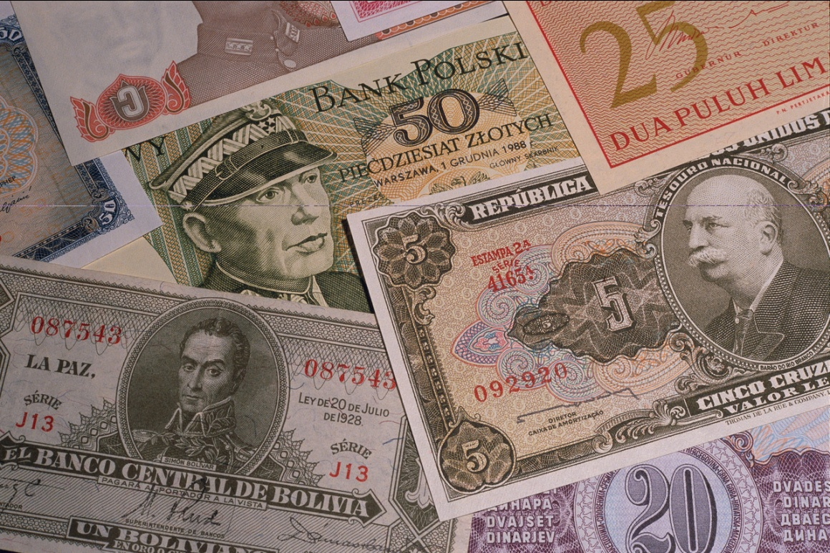
How do banks make a profit?

Slide 15

Loans
When banks lend money to their clients, they will get back more money than they originally lent to the borrower.
This is because the borrower pays an interest rate on the amount that he or she borrows.
The bank can decide what the interest rate will be on a loan.
Loans that take longer to pay back usually have a higher interest rate. Loans that are paid back quickly usually have lower interest rates.

Slide 16
Loans
Why might your fellow students need loans?

Slide 17
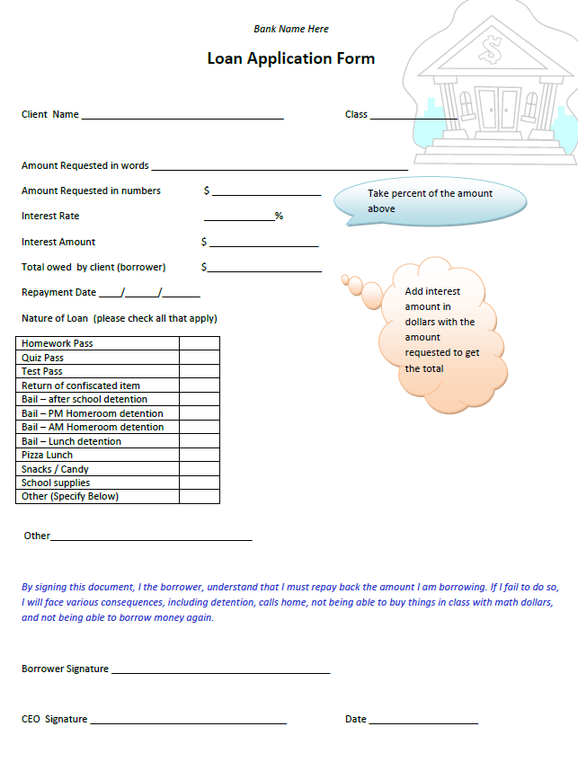
Loans

Slide 18
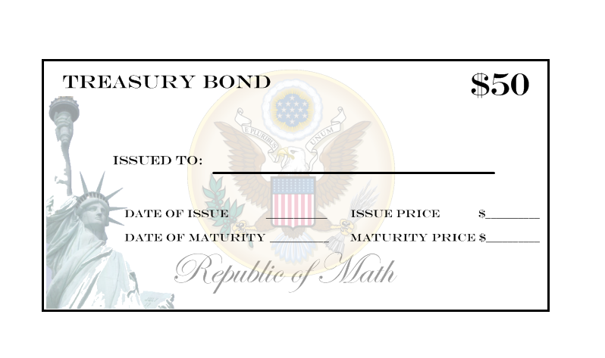
Treasury Bonds
Treasury bonds are documents issued by the government (me).
There are bonds you can buy for $50, $100, $200, and $500
Why would a bank want to buy bonds anyway?

Slide 19
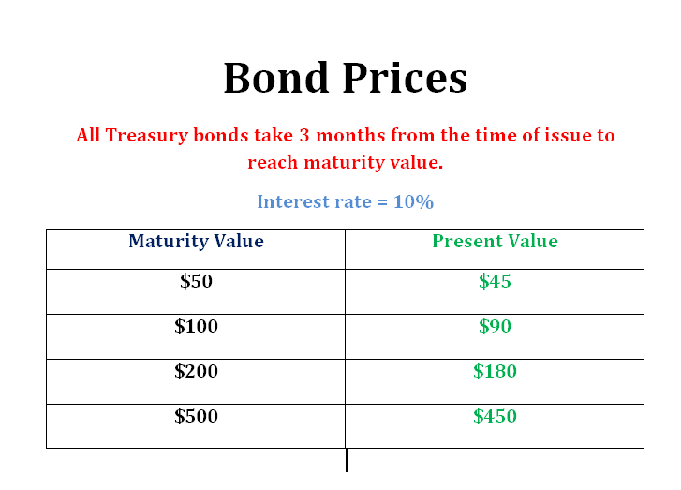
Treasury Bonds
How might a bank take advantage of this?

Slide 20
Treasury Bonds
For example, Bank of America buys a $50 bond right when it is issued in September. Even though the value written on the bond is $50, it will not actually be worth that amount until 3 months have passed, or in December, when it matures.
Another example: Jenny buys a $100 bond, which really costs $90 right now. After three months, she goes to exchange the bond for cash. She will get back $100, which is 10% more than what she started with!!!

Slide 21
Banker Roles and Responsibilities
CEO
The head honcho, the main man
COO
The bookkeeper. This person is responsible for organizing the bank statements and making sure they are filled out correctly.
Marketing Manager
This person will advertise for the bank.
They can talk to people and try to get them to open accounts in the bank. Advertisements that include new interest rates, deals, etc can be posted in the classroom with my permission. You can also advertise on the website!
Responsible for signing off on loans, for setting the interest rates, getting his bank together for meetings, and making sure everything is organized and runs smoothly
The CEO will be the main contact with me
This is the main person dealing with the money. They are responsible for the transactions (deposits and withdrawls)

Slide 22
Banker Roles and Responsibilities
The CEO may hire more people with other responsibilities if he or she wishes.

Slide 23

Requirements
Each bank must have a ….
LOGO
SLOGAN
EX: “Chase what happens”

Slide 24
Requirements
Each bank must create a 5 – 10 minute power point presentation that persuades students in the class to open an account with them.
The presentation should include your slogan and logo, your mission statement, why your bank is better than others, what are your interest rates for savings and loans, etc.
You can include information from this presentation in your presentation also (this presentation is on the website).
…..Remember each student MUST open an account in order to get the $30 they are owed by me.

Slide 25
THANK YOU FOR YOUR TIME AND INTEREST IN THE BANKING PROGRAM!!
Questions?????

